Slide 1
WLAN0802
Hitting the Target Language at All Levels

Slide 2

STRATEGIES TO HELP KEEP YOU IN THE TARGET LANGUAGE

Slide 3

Why do I need to stay in the target language?
Research and practice

Slide 4
Research
Research has shown that the predominant use of the TL by both the teacher and students in a language classroom benefits the language learner and promotes second language.
Notes:
Comprehensible input – learner must be able to understand MOST of what the speaker is saying in order to understand. Must build up form-meaning connections. In order for words to make their way into the learner’ mental representation of the language system, they must be linking to some kind of real-world meaning.
Meaning-bearing – language must contain some message to which the learner is supposed to attend.
Example: Imagine you are sitting on a plane in front of two people speaking a language you don’t speak. As you listen to their conversation, what would you understand? Let’s say you are a beginning student of the language you hear spoken. What are you likely to capture of the conversation? Let’s say that you dropped something on the floor and one of the people sitting behind you calls your attention to it, using the language? Would you understand that the person is speaking to you and that you need to focus on what they are saying? What would that person do to help you understand?

Slide 5
American Council on the Teaching of Foreign Languages
“ACTFL therefore recommends that language educators and their students use the target language as exclusively as possible (90% plus) at all levels of instruction during instructional time and, when feasible, beyond the classroom.”
From ACTFL Position Paper:
“Use of the Target Language in the Classroom,” May 2010
Available at:
http://www.actfl.org/i4a/pages/index.cfm?pageid=4368#targetlang

Slide 6
Why don’t we do that more?
The goal is to use 90% the TL so…
In groups discuss and create a “dirty dozen”
Think of your answers to the question in the Polleverywhere question that you answered as you were coming in today.
Notes:
Sandy: Ask teachers to talk with a shoulder partner about some reasons why we are challenged to achieve this goal. Explain the concept of the “dirty dozen” quickly.
Pepa: explain how she has done dirty dozen.
5 minutes

Slide 7
How do I keep my class at the 90%?
strategies
Notes:
Pepa

Slide 8
ACTFL’S 8 SUGGESTIONS
Provide comprehensible input that is directed toward communicative goals;
2. Make meaning clear through body language, gestures, and visual support;
3. Conduct comprehension checks to ensure understanding;
4. Negotiate meaning with students and encourage negotiation among students;

Slide 9
ACTFL’S 8 SUGGESTIONS
5. Elicit talk that increases in fluency, accuracy, and complexity over time;
6. Encourage self-expression and spontaneous use of language;
7. Teach students strategies for requesting clarification and assistance when faced with comprehension difficulties;
8. Offer feedback to assist and improve students’ ability to interact orally in the target language.

Slide 10
My “10” Strategies

Slide 11

#1
Believe it!
…and believe that they can!
At level 4, at level 3, at level 2, at level 1…..
Notes:
In the classroom, when it comes to the language, you, the teacher, are the expert, and your students expect you to be able to speak the language.
Math uses math terminology, etc.
1 minute

Slide 12
Set Goals
Help students set goals.
Stick to the goals.
Don’t give up!

Slide 13

Challenges
Different difficulties for different levels
  Novice: Levels 1 and 2
  Intermediate: Levels 3 and 4
  Advanced:
Notes:
Rustin: Ask teachers to provide some of the challenges that they face in the classroom with getting the students to hear and use only the TL. Let them provide the examples. I’ll record their answers on a large sheet of paper to refer back to later.
Here are a few suggestions:
Beginners
Making yourself understood
Providing learners with enough language to speak-survival expressions
Intermediate:
Getting students to talk more freely
Making yourself understood when discussing complex ideas
Pushing students to use complex language
Advanced:
Pushing students to use complex language
8 minutes

Slide 14

# 2
Be consistent.
Notes:
Sandy

Slide 15
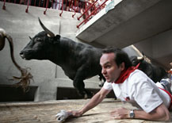
If you are using English, are you doing so for a particular reason?
Notes:
10 minutes

Slide 16

# 3
Involve your students as participants in the process. Make use of games, have a system in place to reinforce the use of the TL. Keep it fun!
Notes:
Sandy: Make it a game. Not talking about games, per se, such as Jeopardy, fly swatter, that we have used in the past.

Slide 17
Forfeit system
Appoint a “secret” police officer each lesson.
Notes:
Sandy:
Appoint a “secret” police officer for each lesson.
At the end of the activity, the police officer reveals, or reads out, any expressions that he or she heard used in English.
These are then stuck onto a “bin” and the person who said them has to find out the TL equivalent and write it on the card or pay a fine.
1 minute

Slide 18
Timer
See how long (use a timer) the class can keep talking only in the target language before someone starts to speak in English.
Create rewards
Notes:
What kinds of low cost, no food or candy involved rewards could you use?

Slide 19
Capture the flag-game
One flag per group. (flags -Spanish speaking countries).
Goal- keep the flag until the end of the week-that indicates that the group has used the TL.
Groups can loose their flags if they speak English.
When English is acceptable, show the United States flag.

Slide 20
#4
Contextualize your lessons
Notes:
Sandy: No verb charts. No translations. No lesson objectives focused only on grammar. It’s easier to stay in the TL when you’re teaching in context.
1 minute

Slide 21

  Create a context through which the student would be able to understand the vocabulary.
Use authentic resources: keep instruction meaningful, and relevant.
Teach grammar in context
  Story-based grammar instruction
  TPRS
Notes:
Sandy: One teacher in the district brings articles from online newspapers to class daily and asks students to read and react to the articles. What kinds of things do you do to teach language using current, authentic materials?

Slide 22


Break
http://www.online-stopwatch.com/
Notes:
Set online timer linked to page

Slide 23
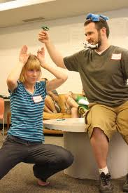
Total Physical Response (TPR)
Assumptions
Pros
Cons

Slide 24
TPRS
Now let’s watch a demonstration.

Slide 25
#5
Plan your instructional vocabulary-use pictures, gestures, signs, etc.
Notes:
Sandy

Slide 26
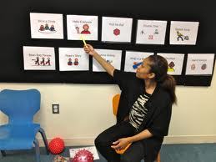
Try to simplify language.
Use cognates.
Repeat terminology on a regular basis. Always use the same classroom instructions.
Use visual aids or props.
Use text to support your spoken words.
Place posters with survival expressions.
Speak more slowly.
Don’t overload students with too much new information.
Notes:
What kinds of visuals do you use?

Slide 27
#6
Remember the
3 C’s:
The TL you speak should be…
Notes:
What you say in the TL should be…

Slide 28
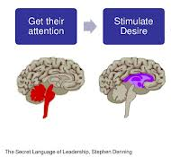
Compelling:
Should evoke interest, call attention, or cause admiration in a powerfully irresistible way

Slide 29


2. Contextualized

Slide 30

3. Comprehensible

Slide 31
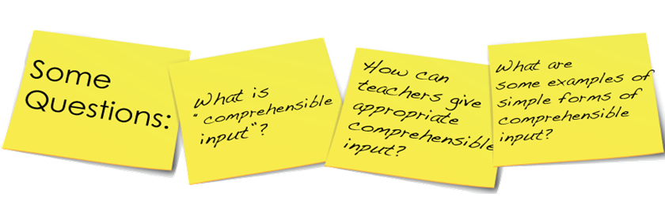

Slide 32
Comprehensible input
Check for understanding:
YES or NO questions
Thumbs up or down
Simple questions – one word answers.
Using white boards
Teach common survival expressions: repita por favor, tengo una pregunta, no entiendo, etc

Slide 33

Van Gogh’s Bedroom

Slide 34
#7
Strive for “successful” versus “correct” communication and
provide students with tools.

Slide 35
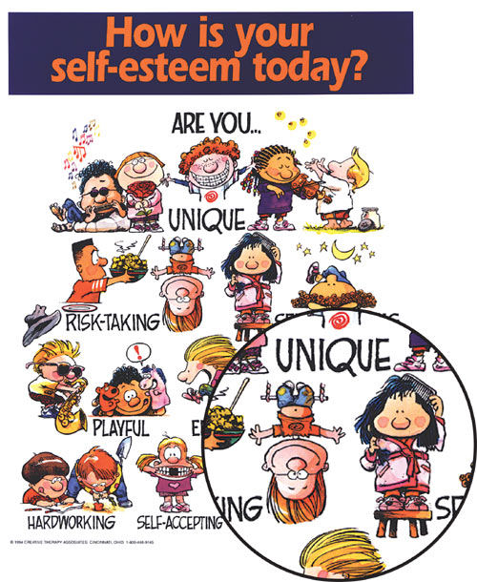

Slide 36

Strategies for teaching grammar in the target language.
Use props and visuals.
Let students discover grammar structure first within context, then explain. Let the structure support the context rather than the context supporting the context.
Use the “flipped” classroom” strategy.

Slide 37

Do’s and Don’ts of grammar correction
Do not interrupt learner in the middle of a sentence to correct grammar – it interferes with the conversation.
Do clear up errors that interfere with understanding.
Do repeat the word or phrase the way you would say it.
Do talk about common errors you have observed rather than singling any one student out.

Slide 38
#8
Be a model for your students.

Slide 39
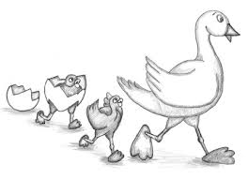
Model for your students how to keep in the TL.
  Demonstrate self-correction and thinking out loud
Teach them how to keep you in the TL.
Speak in the TL with your colleagues every time you get a chance..

Slide 40
#9
Accountability!

Slide 41
Daily Accountability
Check for understanding:
YES or NO questions
Thumbs up or down
Simple questions – one word answers.
Using white boards
Teach common survival expressions: repita por favor, tengo una pregunta, no entiendo, etc

Slide 42
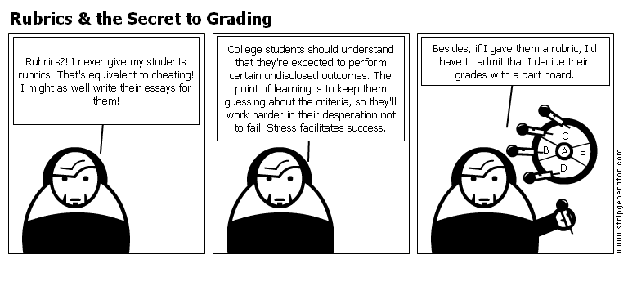

Slide 43
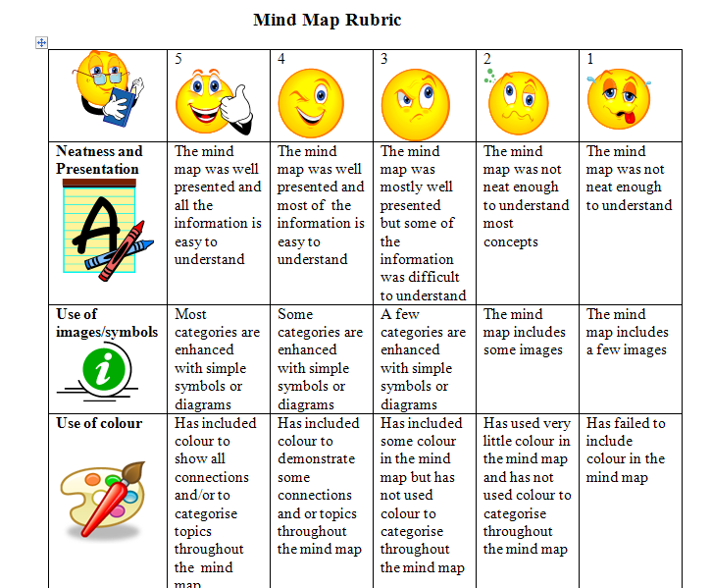
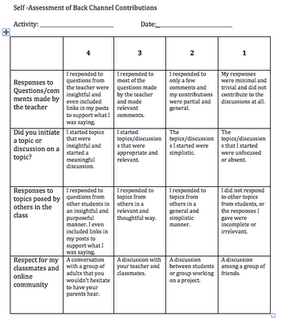
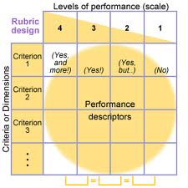

Use rubrics

Slide 44
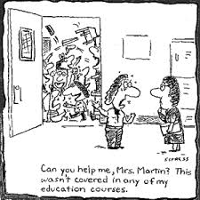
#10
Set routines.

Slide 45
Routines
Be consistent
Practice routines the first weeks of school.
Explain game steps, activities, so later you don’t have to use English.
Teach classroom survival expressions the first days of school and once they are taught, don’t use English for those expressions.
Post classroom survival posters in your classroom and on your students' desks.

Slide 46


Calentamiento-Hoy es el 4 de junio del 2013.
Sientate y copia la tarea en tu agenda.
Saca una hoja de papel.
Escribe tu nombre.
Copia la fecha de hoy.
Ordena las frases:
Ir/al baňo/puedo/ por favor/ ?
Todo/ de/ mesa/ la/ quita.
Pizarra/ la/ mira
Una/papel/saquen/hoja/de

Slide 47
RECAP
Believe it!
Be consistent
Involve your students
Contextualize your lessons
Plan your instructional vocabulary
Remember the 3 C’s
Strive for “successful” versus “correct” communication
Be a model for your students
Accountability
Set routines

Slide 48
Enjoy the journey!

Slide 49

Using authentic resources
Songs

Slide 50
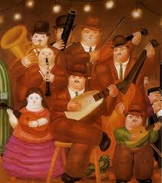
Using authentic resources
Notes:
Other resources will be added to the Weebly that provide these links.

Slide 51
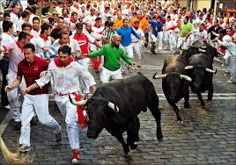
Using authentic resources
Articles and events
Notes:
Other resources will be added to the Weebly that provide these links.

Slide 52

What is your goal for the next school year?

